Slide 1
dbt
May 2022

Slide 2

Agenda
What is dbt
How DBT can help with transformation needs
Reference DBT architecture
Trade-Offs
dbt main object types
dbt commands

Slide 3

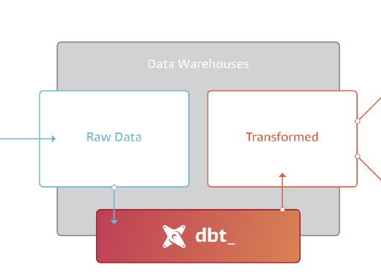
What is DBT?
dbt is a tool that enables data analysts and engineers to transform data in their warehouses more effectively by writing SQL select statements
ata
uild
ool
It’s the T in ELT. It doesn’t extract or load data, but it’s extremely good at transforming data that’s already loaded into your warehouse
Notes:
Simple explanation of what the tool is meant to do

Slide 4
How DBT can help
Computational work is pushed towards your data warehouse
Allows automated testing of your data
It doesn’t require any specific skills. Main skill required is SQL
Version control is built into the tool
Open source and open to customization
Documentation lives with your DBT project and it is automatically generated from your codebase
Orchestrating a DBT pipeline requires minimal resources
Well documented and the learning curve is not very steep
Notes:
Pushing computation work to the DW allows high performance when using a technology similar to BigQuery or Snowflake.
Tests can be built along with transformations. These tests can be both standard (uniqueness, referential integrity) as well as custom
Most of the code is based on SQL-writing. It also uses a python-similar language, which can be easily understood by engineers with programming language experience
Version control is built in with Github
There’s an active DBT community. Packages and custom macros are constantly being shared. Talk about the cost-analysis package
Documentation (table and column comments) and table-level dependencies are generated by the tool
Orchestration can be done as easily as a cron tab, also has hooks to allow integration with tools like Ctrl-M
Along with the active community, official documentation is good. Also, at it’s core, it’s simple

Slide 5










Reference architecture
Data Sources
Data Engineering
Consumption
environment
Reporting
Stage
Transform
Prepare
Cloud databases
RAW STG Tables
Star Schemas
Semantic Layer
Data Ingestion
Legacy databases
CDC/Hashing
Snapshots
Historic visibility
Transformation and denormalization
DIM and FACT tables
Semantic layer views and aggregates
Machine Learning
Power Users
Consumption layer to support reporting tools like Power BI, Tableau, Self service, etc
Files
Cloud
Notes:
Specify that DBT is only the transformation layer
Ingestion is still needed by tools like Matillion IICS or Fivetran
Staging layer includes CDC management, which can be either transaction timestamp based or hash-based for entities without timestamps. Both built into DBT
Transformation layer transforms data into facts and dims, dimensional model
Semantic layer can be an additional component of data warehouses. Includes more business logic and preparation of the data to be consumed by the consumption layer
Provides a more consistent way of consuming and interpreting data
Should reduce Reporting layer complexity
Consumption can be done with any tool that can connect to Snowflake, like PowerBI or Tableau

Slide 6
Trade-Offs
It covers only the T of ELT
DBT is, mostly, SQL-based
Debugging capabilities are limited
Overriding standard behavior requires understanding internal functions
Notes:
Extraction and load still need to be covered by another application, like Matillion, Fivetran, IICS
As it is mostly sql-based, good SQL skills are required to understand code.
Also, if relying heavily on the Python-like scripts, programming language understanding would be needed.
There’s no graphic representation of the transformation logic. If you open an Informatica mapping, you get the gist of how columns are being transformed
Since most of what DBT does is push queries against the database, debugging is limited to the what can be seen in the db.
There’s no breakpoints like in other programming languages. This is especially a problem with complex macros
Sometimes you will find yourself overriding DBT standard behavior, rewriting macros that are used behind the scenes. This requires an understanding of the source code.

Slide 7
dbt main object types
Table objects
Models
Snapshots
Seeds
Other objects
Macros
Tests
Configuration (ymls)

Slide 8
dbt cloud
Jobs
Environments
Notifications

Slide 9
Models
Main object used for writing data into tables or creating views
Logic is written within a SELECT statement. This SELECT is then written into the database
Filename is used as the table name
Triggered by the dbt run command
How this data is written varies based on the materialization configured
It’s strongly recommended to use the ref function to reference other models/snapshots when writing new models
Recommended to use CTEs to organize the code
Models can also be tested and documented

Slide 10
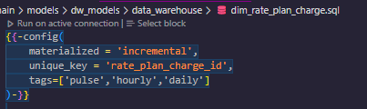
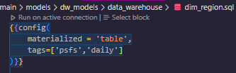
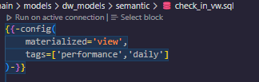
Models - Config parameters
materialized: Main types are:
table: The SELECT statement of the model will be executed as part of a CREATE OR REPLACE TABLE
Incremental: After the first execution of the model, the SELECT will be executed as a MERGE (matching via the unique_key)
Running an incremental table the first time is the same as running a table materialization
view: The SELECT will be executed as part of a CREATE OR REPLACE VIEW
unique_key: Needed by the incremental models. Used internally for the MERGE of incremental loads
tags: Allows selective execution of models. Used by the dbt run command

Slide 11
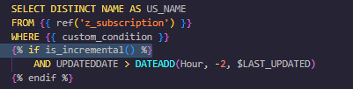
Models – Materialization considerations
Column changes aren’t automatically reflected in incremental materializations. A full-refresh is recommended after schema changes
table materializations are usually easier to write than incremental but have worse performance. They’re still a very viable option for smaller tables. A good rule-of-thumb is to use table for tables that will always remain under 1M rows
Incremental materializations are best accompanied by delta logic. More info on incremental configuration found here
A recommendation on warehouse design is that models should be designed to always be full-refreshable. History is better kept in snapshots to allow this recalculation at any moment
The is_incremental() function returns a TRUE/FALSE based on whether an incremental table is being executed incrementally or not. More details found here
FALSE is returned when the table doesn’t yet exist or when a full-refresh parameter was passed to the dbt run command

Slide 12
Snapshots
Similar to a model, but it has built-in functionality to behave like an SCD type 2
Delta monitoring can be done based on an update date (timestamp strategy) or a comparison of values (check strategy)
Version of records can be tracked using the dbt_valid_from and dbt_valid_to columns
Triggered by the dbt snapshot
In data warehouses, snapshots are a simple way to create a staging layer
It’s a good practice to save staging snapshots in a different schema
More resources:
Snapshot configuration best practices
Snapshot query best practices
Snapshot meta-fields

Slide 13
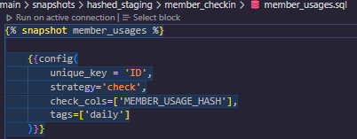
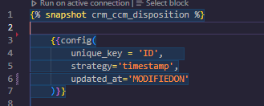
Snapshots – Main config parameters
unique_key: PK/NK of the source data. Used by dbt to build the SCD type 2 history
strategy: Indicates if snapshot should be refreshed based on a date changing (timestamp) or values changing vs previous version (check)
updated_at: Used by the timestamp strategy. This column value is compared against the previous version of the same unique_key column (if exists) to know if record has changed
check_cols: Used by the check strategy. This column(s) value is compared against the current value for the unique_key to know if there has been any changes
Tags: Same use as in models

Slide 14
Seeds
Seeds are used to easily load CSV files into a table
They can be referenced downstream the same way as models (with the ref function)
Their best use case is static data that rarely ever changes
They are executed via the dbt seed command
More info on seeds found here

Slide 15

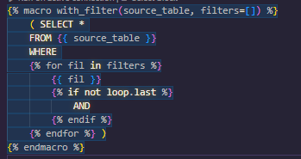
Macros
Macros are functions built with Jinja
Macros are meant to help with repetitive query tasks
They shine the most when dynamically creating SQL based on provided parameters
Macros also can be called directly via the command line (with the dbt run-operation command)
Macros can receive parameters. Parameters can also be defaulted to a value in case the macro is called without them
More info on Jinja & Macros found here

Slide 16
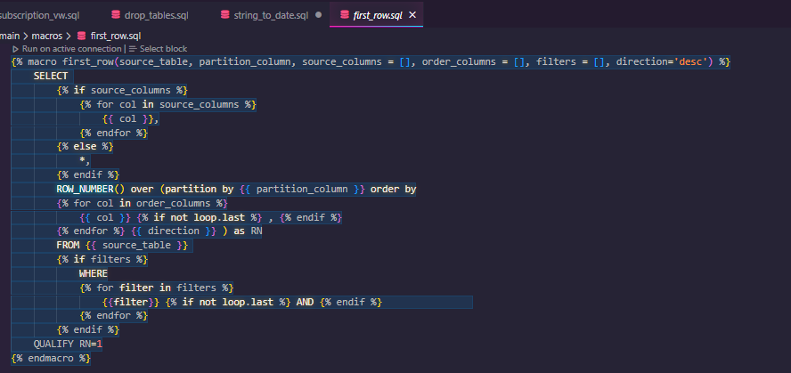
Macros – Example 1

Slide 17
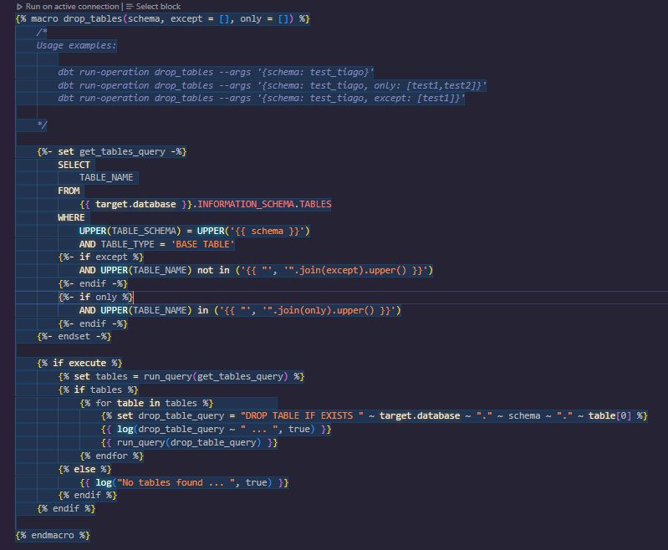
Macros – Example 2

Slide 18
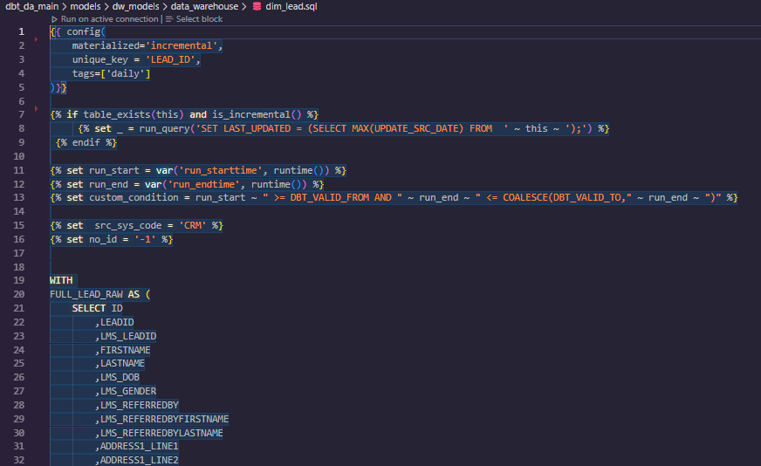
Macros – Important considerations
Favor readability over DRY-ness (DRY = Do not repeat yourself)
Leverage package macros
Set variables at the top of a model

Slide 19
Tests
Tests are meant to be written as a SELECT query
There are two types of tests, simple tests and generic tests
Simple tests are a SELECT statement. The test will be considered failed when the SELECT returns >0 rows
Generic tests are meant to be reusable. They are a specific type of macro
Generic tests receive parameters which allow for them to be reusable. dbt has several of these already built in, like unique, not_null, accepted_values and relationship
Generic tests can be referenced throughout configuration ymls, like those used for sources or models
Additional info on tests can be found here. dbt also has a guide for writing Generic tests here

Slide 20
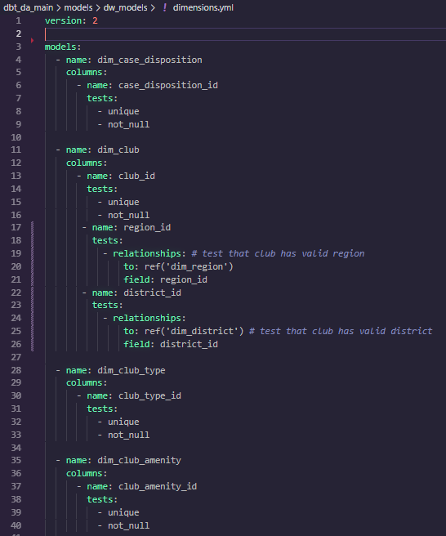
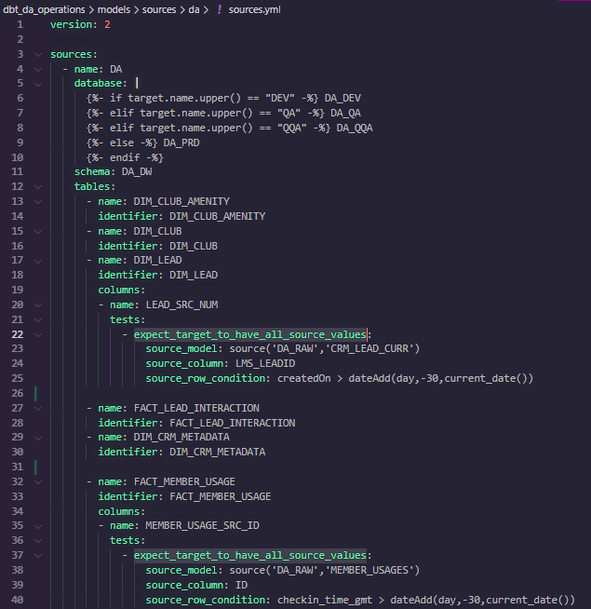
Tests – YML config for Generic tests

Slide 21
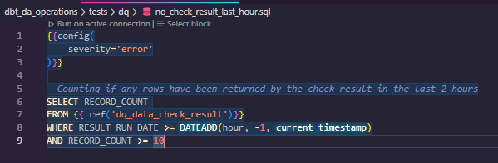
Tests – Simple test example

Slide 22
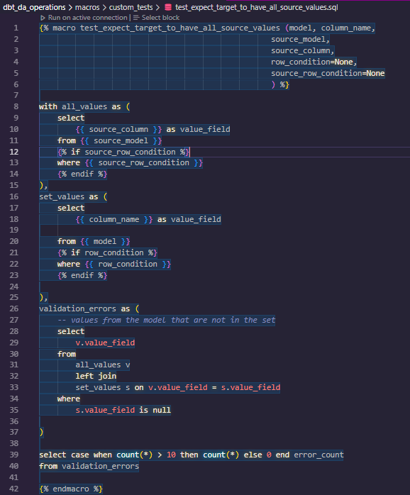
Tests – Generic/Custom test example

Slide 23
YMLs
YML files are used by dbt for configuration and documentation
The main ymls for dbt projects are:
dbt_project.yml
profiles.yml
packages.yml
models.yml
sources.yml

Slide 24
dbt_project.yml
This file tells the dbt executable that the folder is a dbt project
It contains a lot of configuration parameters for the project, some of the key ones are:
name: Includes the name of the project
profile: Main profile used (for dbt CLI)
model-paths, analysis-paths, test-paths, macro-paths, snapshot-paths
models: Includes configuration to be shared across all models. Allows folder-level configuration
snapshots: Includes configuration to be shared across all models. Allows folder-level configuration
dbt_project.yml reference is found here

Slide 25
profiles.yml
This is mostly needed for when using dbt as a CLI execution. dbt cloud takes care of the profile configuration
dbt obtains the profile to use from the dbt_project.yml file. dbt then looks for a profiles.yml
This file can be placed in a default path. In Windows, you can also set up an env var for a custom path
The profiles consist of the targets, including their connection information
Reference for profiles.yml found here
If this yml has username/password information, it’s recommended that it lives outside of the main project

Slide 26
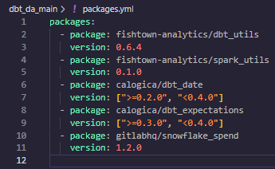
packages.yml
A package is the same concept as a library in other development languages
These are shared collections of macros and/or models that include reusable functions to simplify our processes
dbt hub is a registry for dbt packages. These can be referenced in the packages.yml file
If using CLI, packages need to be installed once with the dbt deps command
This yml lives in the root of the project

Slide 27
Resource config
Resources in the dbt projects are models, snapshots, seeds, tests, sources, among others
Each resource type has a specific set of properties which can be defined in .yml files
These yml files don’t need to have a specific name, so it’s recommended to standardize what they’re called
More information can be found here

Slide 28
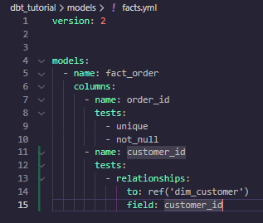
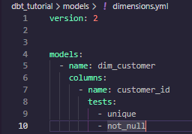
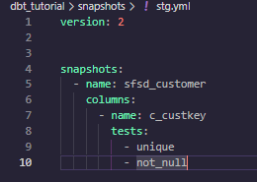
Resource config – Models & Snapshots
Model config files live in the models/ directory. Snapshot files live in snapshots/
It’s usually used to document the models or snapshots being created in the project
It can also be used to add generic tests to these resources
You can have a single file with all your resources, or as many files as it makes sense
Model property reference can be found here. Snapshot property reference can be found here

Slide 29
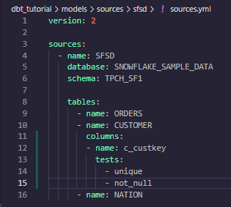
Resource config – Sources
Sources configuration also lives in the model/ directory
It’s useful to add different databases (within the same cloud platform) as a source for the project
Just like with models, this can also be used to add generic tests to these resources (including freshness testing)
You can have a single file with all your resources, or as many files as it makes sense
For sources, it might be useful to create a yml file for each different source database
Source property reference can be found here
Recommended
Have a different folder per source
Have a different yml per source

Slide 30
dbt commands
snapshot
run
compile
test
seed
deps
debug

Slide 31
Sample development – Adding a new fact table
Create/update sources.yml (if a new table is being sourced)
Create staging snapshot for new table(s)
Create fact table model
Create semantic layer model (if needed)

Slide 32
Topics to reinforce
dbt local
Seeds
Environment configuration
Snowflake + dbt + github
Include “multi-environment” platform type (dev/qa/prd)

